Slide 1

TRANSLITERATION
Mind it!!!
Its “TRANSLITERATION” and not “TRANSLATION”

Slide 2
What is transliteration?
Transliteration is when you convert a word written in one language such that it is written using the alphabet of the second language.
Note that this is very different from “Translation” wherein you also convert the word itself to the second language so that it’s “meaning” is maintained.
We hardly think about transliteration which is very useful to pronounce text written in a language which we don’t know how to read.In this case,translation is not useful.
Eg:Kothanur Dinne is transliterated from Kannada.It cannot be translated from Kannada to English for it’s a locality in Bangalore!Kothanur is the same in all the languages!
Some words like chudidaar,pyjaama,kimono and food items like chapathi,poori,roti,gobi manchuri etc., need transliteration and not translation.
LITERALLY WRITING IT AS “KOTHANUR” in all the other languages too!

Slide 3
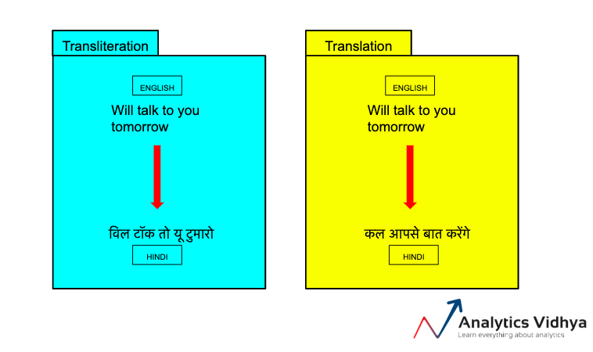

Slide 4
USES OF TRANSLITERATION
Address verification
International news with references in some unknown languages
Restaurant menus
Libraries-searching for books

Slide 5
Why is transliteration so important for address verification?
Customer addresses stored in their regional languages
Imagine that you have customer addresses from all over the world in your database. They are saved in their original languages. But since you can’t read Russian, Arabic or Chinese for example, you can’t tell where the customers are located. You’d like to see them spelled out in a common native language, in this instance, English, so you can do further analysis. That’s assuming that your CRM software is even capable of handling different languages. If it isn’t, then you simply won’t be able to service those customers.
Address verification software has already been developed abroad to overcome such challenges.

Slide 6
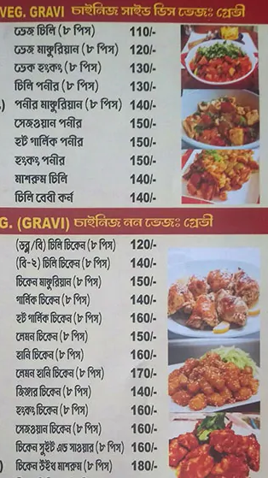
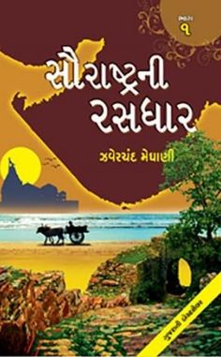
A Bengali restaurant menu!!!
A Gujarati reference in the library.How do we search for the book unless we know its name?

Slide 7
Transliteration is more prevalent than you may have realized. Whenever you read about international news, you should be thankful for transliteration! We’re guessing most people would be rather confused if news articles were peppered with references to 京, الدولة الإسلامية في العراق والشام, or Мосва instead of their Latin-alphabet equivalents: Beijing, ISIS or ISIL, and Moscow.
Restaurant menus are also common places where transliteration is also used.
Additional places include libraries where transliteration allows people to perform searches for content in different writing systems; the academic world especially in research papers; and in our everyday language.
Words like karate (Japanese) and pajamas (Urdu) were borrowed by the English language and transliterated from their original text into the Latin alphabet.
A lot of research is still going on in this area.A 2010 research paper based on the need of transliteration for bilingual children is a noticeable work.
The above works must be extended to our INDIAN LANGUAGES AS WELL.

Slide 8
DEMO
A short demo with a few test cases.
You can,of course,explore more!!!

Slide 9
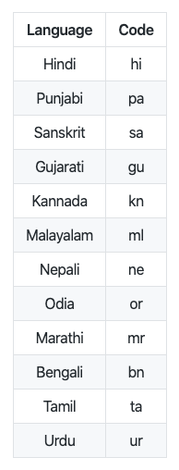
Libraries used
Detect the language of the input text: langdetect
Transliteration: Indic-nlp which supports several languages of the Indian subcontinent
Languages supported are given on the right
I have excluded Odia and Sanskrit for the demo as some characters of Odia cannot be detected by langdetect and Sanskrit is hardly spoken anywhere!

Slide 10


Slide 11
References
https://www.analyticsvidhya.com/blog/2020/01/3-important-nlp-libraries-indian-languages-python/
https://www.geeksforgeeks.org/detect-an-unknown-language-using-python/
https://cdn.analyticsvidhya.com/wp-content/uploads/2020/01/Screenshot-2020-01-10-at-12.30.56-PM.png
https://cdn.analyticsvidhya.com/wp-content/uploads/2020/01/Screenshot-2020-01-09-at-11.46.39-AM.png
https://www.tandfonline.com/doi/abs/10.1080/13670050903406335
https://www.accreditedlanguage.com/translation/what-is-transliteration/
https://www.loqate.com/resources/blog/what-is-transliteration-and-why-is-it-important-for-address-verification/
https://scholar.google.com/scholar?as_ylo=2017&q=transliteration+of+indian+languages&hl=en&as_sdt=0,5
MUSIC-NO COPYRIGHTS AUDIO LIBRARY:
https://youtu.be/LHN3w628yTc

Slide 12
